Slide 1
Data Analytics with Python
Real Estate Project
BAN 612 - 03
By Apoorva Nerkar

Slide 2
Introduction
Web Scrapping
Why Redfin?
More sold property data availability
Attribute Selection
Fetched data for Sold and New listings
Extracted 27 attributes like Estimated Price, Sold Price, Commute Score, Property Type etc.
# of Records
Covered 36 counties of California
Division of Work
Varied scope
More accessibility to research question
One of the top real estate websites
Scrapped ~3600 records for Sold and New properties
Each member extracted data for 5 counties (Sold and New)
Same dataset, different research questions

Slide 3
Research Questions
1. Which county has the best walkable, transit and bikeable score? Based on this analysis select the best county and analyze the proportion of schools that fall under following categories:
Walkable (Car dependent, somewhat walkable, very walkable),
Bikeable(very bikeable, bikeable, somewhat bikeable) and
Transit (Excellent transit, good transit)
2. Analyze most expensive and least expensive localities for single family homes based on new listings on Redfin.
3. Analyze the relationship between Price and Area of the houses sold based on number of beds.

Slide 4

Question 1 : Which county has the best walkable, transit and bikeable score? Based on this analysis select the best county and analyze the proportion of schools that fall under following categories: - Walkable (Car dependent, somewhat walkable, very walkable), - Bikeable(very bikeable, bikeable, somewhat bikeable) and - Transit (Excellent transit, good transit)

Slide 5
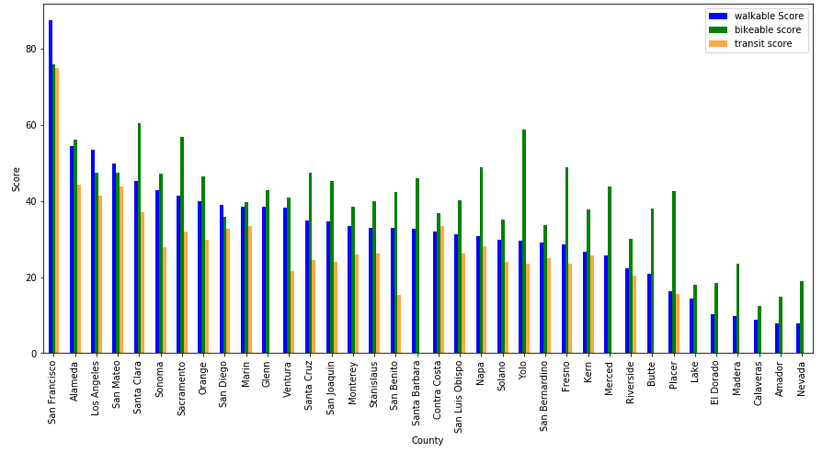
Distribution of average commute score by counties
Insights and Results:
This graph depicts an overall picture of all the counties in California with Average commute scores
From the graph, it can be seen that San Francisco has the best walkable, bikeable and transit score followed by Alameda
Counties like Nevada and Amador with least commute score doesn’t have any transit facilities
Notes:
Commute score for sold and new are significantly similar

Slide 6
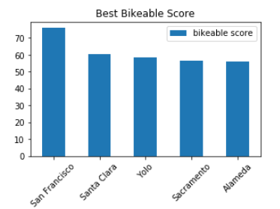
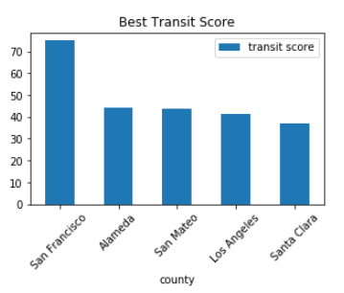
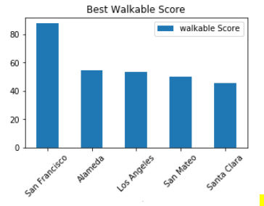







Top 5 counties with best Walkable, Transit and Bikeable scores
Insights and Results:
To have a better look at individual county score three individual graphs have been plotted which shows the top 5 counties with the best walkable, bikeable and transit scores
Among all the three categories, it can be deduced that San Francisco has the best Walkable, Bikeable and Transit scores

Slide 7
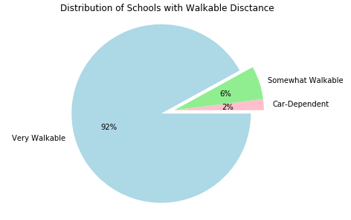
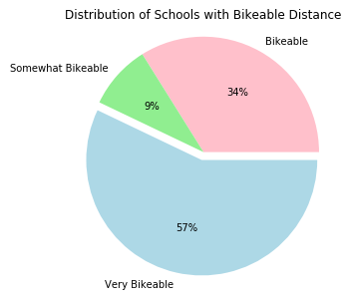
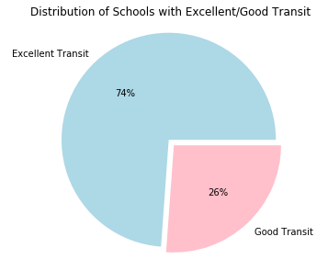
Distribution of # of Schools across each Commute Type at Alameda

Slide 8
Insights and Results
Based on the previous analysis, San Francisco has the highest Commute Score (slide 6).
92% of the schools are at “very walkable” distance from the properties being sold.
57% of schools are “very bikeable” distance from the properties sold on Redfin.
Similarly, 74% of the schools have excellent transit facilities which implies that San Francisco has the best connectivity for Bart, Cal Train, AC Transit buses etc.

Slide 9
Question 2 : Analyze the most expensive and the least expensive localities for single family homes based on new listings on Redfin

Slide 10
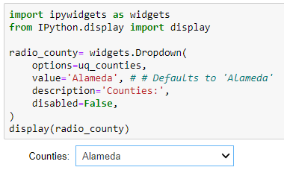
In order to analyze this research question and derive insights the following interactive selection feature was added:
Library used:
ipywidgets
Method used:
widgets.Dropdown

Slide 11
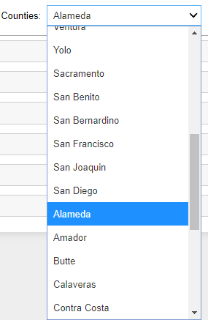
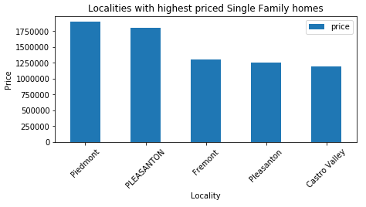
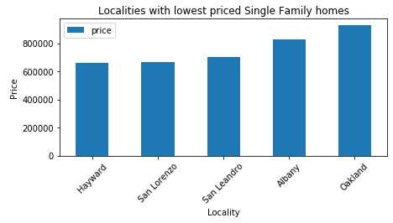
Top 5 and bottom 5 Localities by Price based on Single Family Homes in Alameda

Slide 12
Analysis, Insights and Results
Analysis:
I further deep-dived at Locality level to analyze top 5 and bottom 5 localities by Price based on Single Family Homes according to the County selected from the drop down (Alameda here).
Insights and Results:
Locality Piedmont has highest single-family home prices followed by Pleasanton
Whereas, Hayward has the least price
For a potential buyer Hayward is the best locality to buy a single-family home as it has the best commute as seen in first analysis and cheap prices as compared to other localities in Alameda

Slide 13
Question 3 : Analyze the relationship between Price and Area of the houses sold based on number of beds on Redfin.

Slide 14
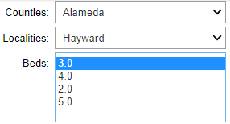
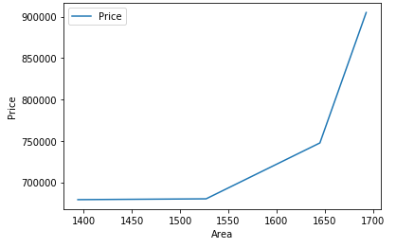
Relationship between Price and Area based on # of Beds

Slide 15
Analysis, Insights and Results
Analysis:
Based on the analysis in above slides (Research question #2) we deduced that Hayward has the cheapest Single-Family Home property prices.
So, this analysis represents relationship between Property Price with respect to its Area for 3 Bedroom houses in Hayward.
Insights and Results:
From analysis of this graph we can say that, property rates doesn’t vary much for smaller area houses but as the area increases the price also increases.
Property price and Area are positively related to each other in Hayward for Single Family Homes. As area increases property price also increases.

Slide 16

Conclusion
A potential buyer who is looking for cheap Single-Family homes but at the same time needs best commute benefits within California he/she should go with Hayward locality because according to the research and analysis shown in previous slides –
Alameda county has the second-best commute in terms of walkable, bikeable and transit score
And, Hayward has the lowest price single family homes in the Alameda county
Hence, buying a property in Hayward will be a good option!

Slide 17
Thank You!

